Slide 1
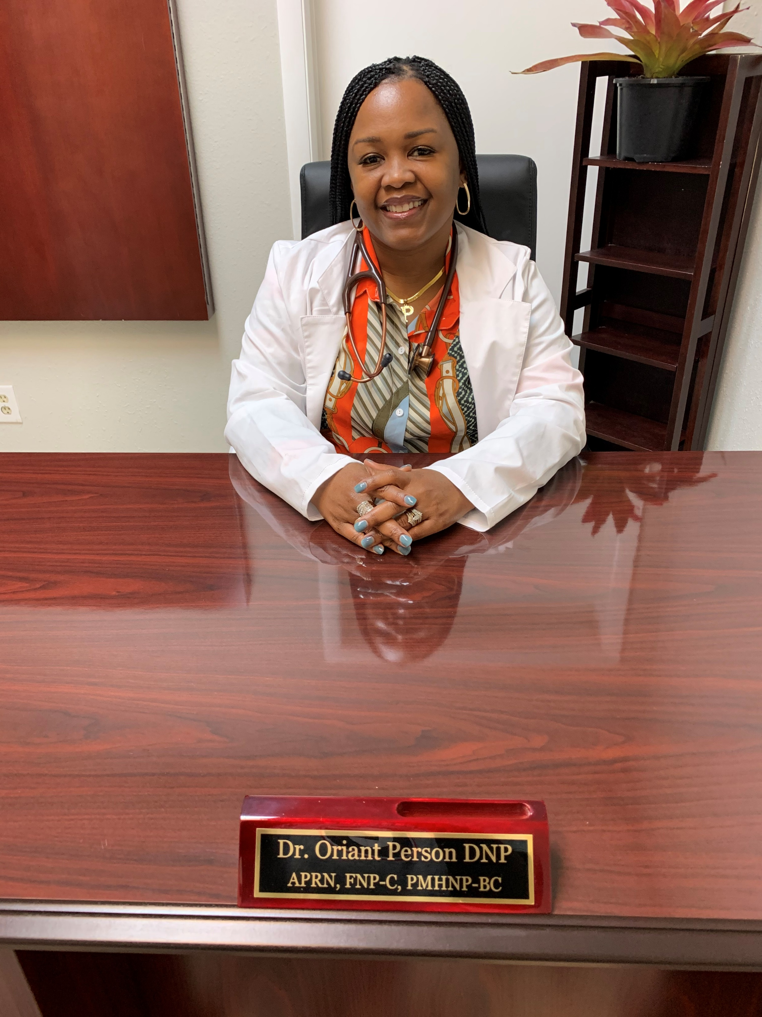
Dr. Oriant Person DNP, APRN, FNP-C, PMHNP-BC
“An Overcomer”
Dr. Oriant Person is the wife of Aric Person and the mother of 4 beautiful children. At the young age of 17, Dr. Person joined the United States Army where her healthcare career began as a Combat Medic. After being honorably discharged, Dr. Person continued in the healthcare field and became a CNA, LPN, RN, APRN, and now holds the Doctorate of Nursing Practice and is a Board-Certified Family and Psychiatric Mental Health Nurse Practitioner.
Professionally, she has been a provider in several hospitals and long-term care facilities in the Tampa Bay area. In 2013, Dr. Person decided to embrace entrepreneurship and started a training center ushering CNAs, Med Techs, and CPR providers into the Southshore Region. In 2015, she started Person to Person Care Center LLC, a 6-bed residential assisted living facility. In 2017 Pathway to Purpose for Males was birthed; a 12- bed group home for males aged 12-17 that have been displaced from their families. In 2020, Preparing for Purpose launched as a transitional housing unit to integrate homeless veterans and civilians back into society. In 2021, Person to Person Clinical Services was birthed to provide primary and psychiatric care to patients in need. Also in 2021, a 6-bed APD group home was re-opened to provide residential habilitation services to our intellectually disabled population.
Above all else, Dr. Person loves and serves God as she serves His people.
Degrees
University of Maryland University College, Europe- Associates of Arts, Computer Programming
Pueblo Community College- Associates of Applied Science, Nursing
University of South Florida- Bachelors of Science, Nursing
South University- Masters of Science, Nursing
University of North Florida- Doctorate of Nursing Practice

